Slide 1
CRYPTOGRAPHY AND NETWORK SECURITY
BLOCK CIPHERS

Slide 2
INTRODUCTION
A block cipher takes a block of plaintext bits and generates a block of cipher text bits, generally of same size.
The size of block is fixed in the given scheme. The choice of block size does not directly affect to the strength of encryption scheme. The strength of cipher depends up on the key length.

Slide 3
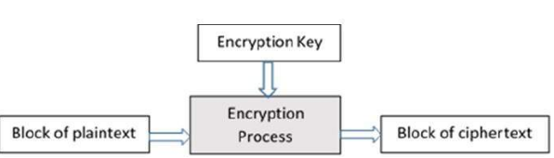

Slide 4
Block Size
Avoid very small block size − Say a block size is m bits. Then the possible plaintext bits combinations are then 2^{m}.
If the attacker finds the plain text blocks similar to some previously sent ciphertext blocks, then the attacker can use a type of ‘dictionary attack’ making use of dictionary of plaintext/ciphertext pairs sent using that encryption key.
A larger block size makes attack harder as the dictionary needs to be larger.
Do not have very large block size − With very large block size, the cipher becomes inefficient to operate. Such plaintexts will need to be padded before being encrypted.
Multiples of 8 bit − A preferred block size is a multiple of 8 as it is easy for implementation as most computer processor handle data in multiple of 8 bits.

Slide 5
Padding in Block Cipher
Block ciphers process blocks of fixed sizes (say 64 bits).
The length of plaintexts is mostly not a multiple of the block size. For example, a 150-bit plaintext provides two blocks of 64 bits each with third block of balance 22 bits.
The last block of bits needs to be padded up with redundant information so that the length of the final block equal to block size of the scheme.
In our example, the remaining 22 bits need to have additional 42 redundant bits added to provide a complete block. The process of adding bits to the last block is referred to as padding.
Too much padding makes the system inefficient. Also, padding may render the system insecure at times, if the padding is done with same bits always.

Slide 6
Block Cipher Schemes
There is a huge numberof block ciphers schemes that are in use. Most popular ones are discussed below
Digital Encryption Standard (DES) − The popular block cipher of the 1990s which is known as a ‘broken’ block cipher, due primarily to its small key size.
Triple DES − It is a scheme based on repeated DES applications. It is still a respected block ciphers but inefficient compared to the new faster block ciphers available.
Advanced Encryption Standard (AES) − It is a relatively new block cipher based on the encryption algorithm Rijndael that won the AES design competition.

Slide 7
Continued….
IDEA − It is a quiet strong block cipher with a block size of 64 and a key size of 128 bits.
Various applications make use of IDEA encryption, including early versions of Pretty Good Privacy (PGP) protocol. Because of patent issues it has got restricted users.
Twofish − This scheme of block cipher uses block size of 128 bits and a key of variable length. It was one of the AES finalists. It is based on the earlier block cipher Blowfish with a block size of 64 bits.
Serpent − A block cipher with a block size of 128 bits and key lengths of 128, 192, or 256 bits, which was also an AES competition finalist. It is a slower but has more secure design than other block cipher.

Slide 8
Feistel Block Cipher
Feistel Cipher is not a specific scheme of block cipher.
It is a design model from which many different block ciphers are derived.
DES is just one example of a Feistel Cipher.
A cryptographic system based on Feistel cipher structure uses the same algorithm for both encryption and decryption.

Slide 9
C ontinued…
Encryption Process
The encryption process uses the Feistel structure consisting multiple rounds of processing of the plaintext, each round consisting of a “substitution” step followed by a permutation step.

Slide 10
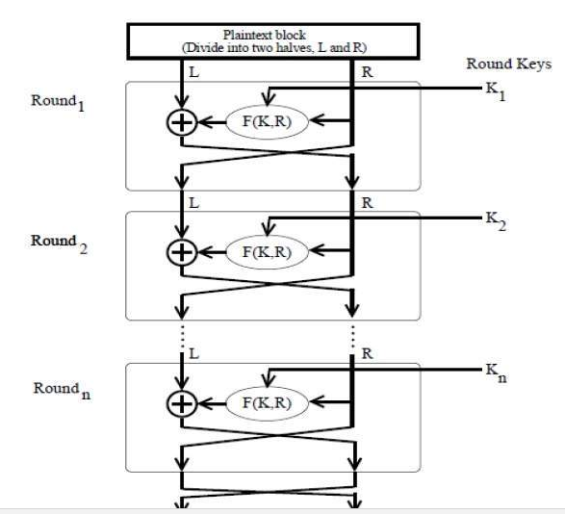

Slide 11
Decryption Process
The process of decryption in Feistel cipher is no different.
In this case, the ciphertext block is fed into the start of the Feistel structure and then the process thereafter is exactly the same as described in the given illustration.
The point where the process differs is that the subkeys used in encryption are used in the reverse order.
The final swapping of ‘L’ and ‘R’ in last step of the Feistel Cipher is essential.
If these are not swapped then the resulting ciphertext could not be decrypted using the same algorithm.

Slide 12
References
Wade Trappe, Lawrence C Washington, “ Introduction to Cryptography with coding theory”, 2nd edition, Pearson, 2007.
W. Mao, “Modern Cryptography – Theory and Practice”, Pearson Education
Charles P. Fleeger, Shari Lawrence Pfleeger – “Security in computing” Third Edition – Prentice Hall of India
“Cryptography and Network Security” by William Stallings.

